Slide 1
Information and hints for AOs
By ANS CZ
Otto Olej / Flow Analyst, National RAD Coordinator

Slide 2
In general
Explanations, hints and tips based on flight planning in LK airspace
PLANNING issues
  Possible RAD solutions, but mostly marginal and not comprehensive
  Before making RAD more complex, we‘re trying to get rid of the problems by offering correct routes to AOs
SW ALGORHYTHMS causing planning issues (?)
INFORMATION SOURCES
  Information can be found on czech AIM website, part FRACZECH
  Planning possibilities graphically represented in interactive tool FRAview

Slide 3
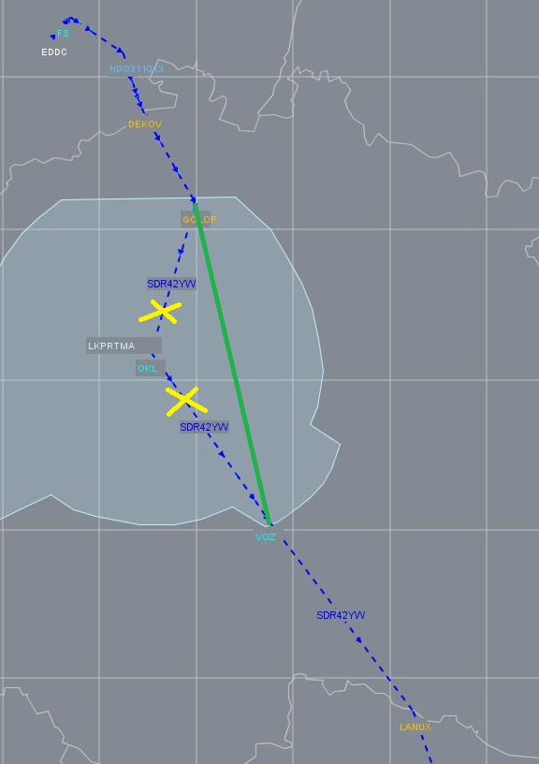
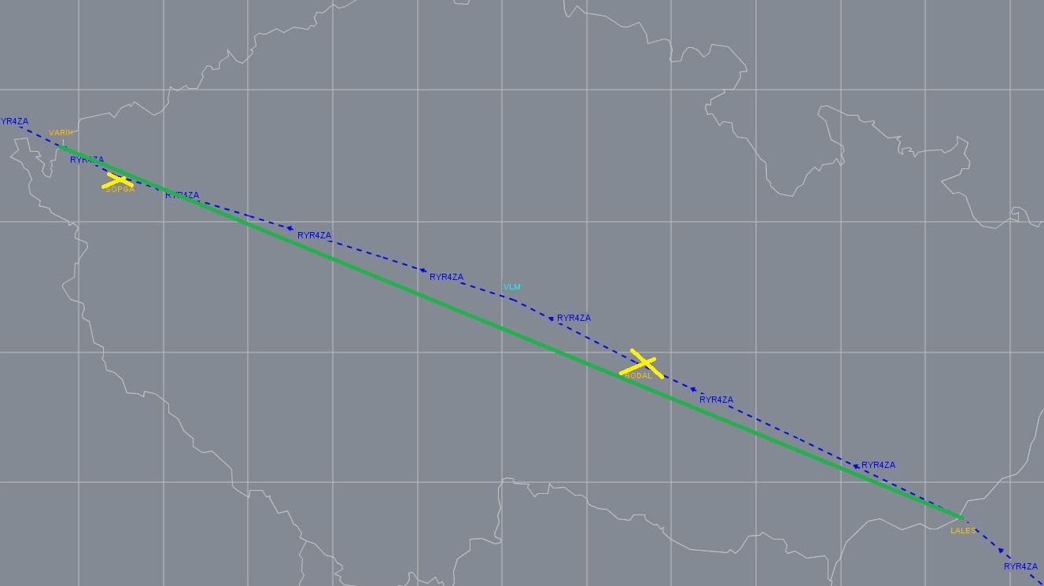
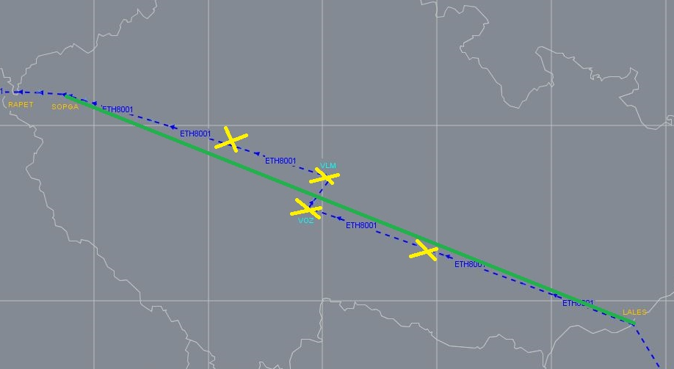
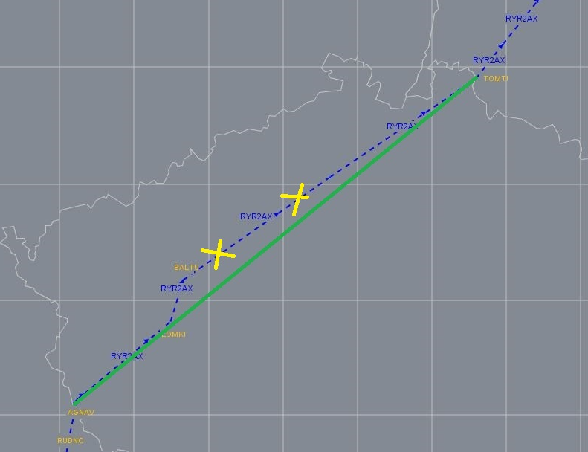
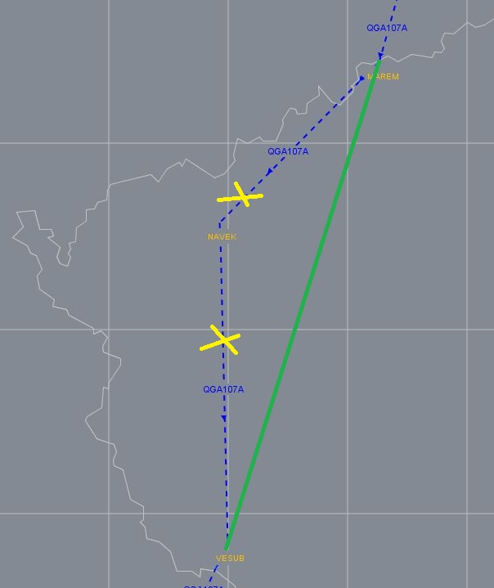
Planning – Unnecessary intermediate points
AOs plan intermediate points, which are not needed
Unexpected and potencionally dangerous FPLs
Some cases may be result of cost-effectiveness (wind)

Slide 4
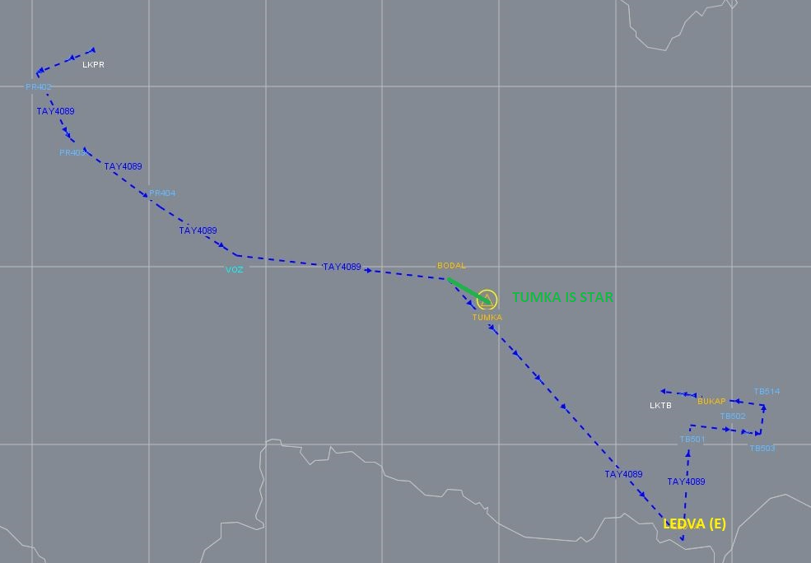
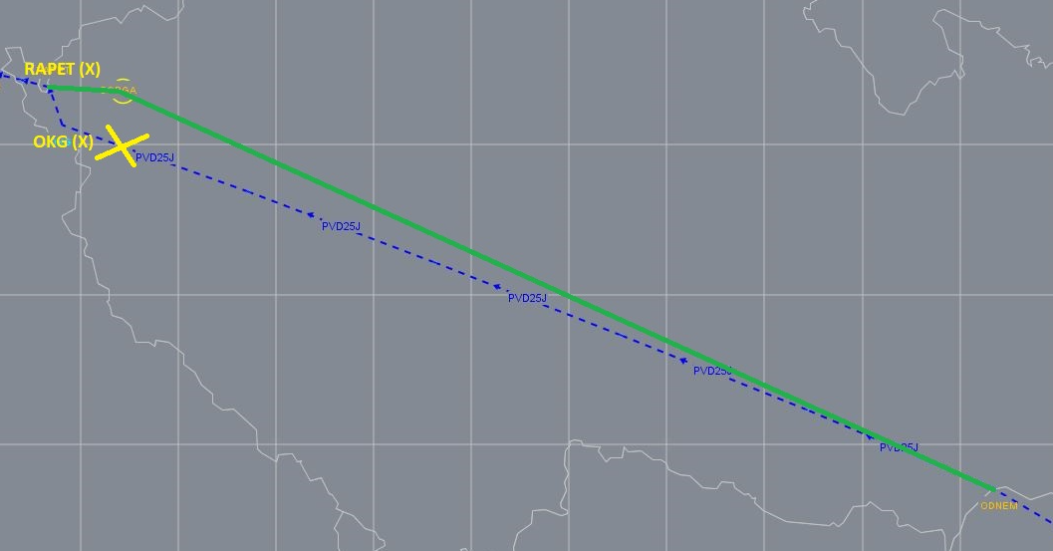
Planning – FRA (E/X) points planned as FRA (I)
AOs plan two following border points
Does not adhere with AIP, IFPS functionality preventing this not implemented yet
Unexpected and potentionally dangerous FPLs

Slide 5
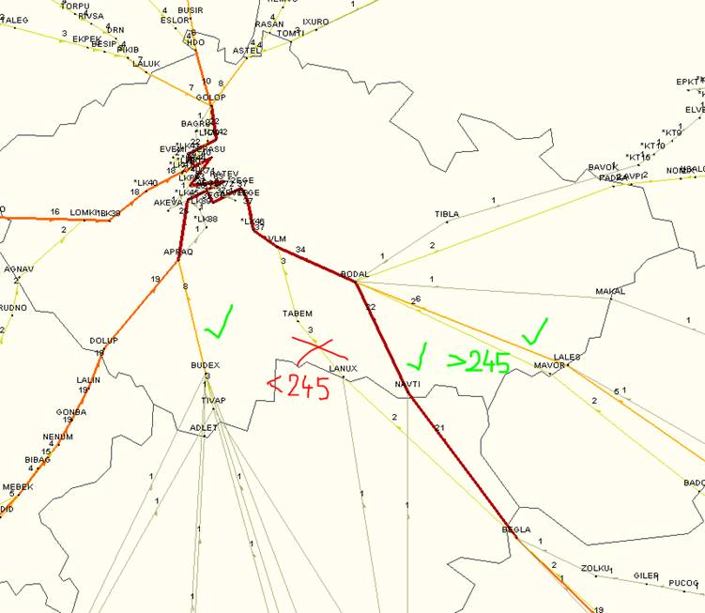
Planning – ARR LKPR descent in LO to avoid RAD
AOs planned descent below FL245 in LO airspace to avoid RAD in LK
The operational intention is not to descend, traffic H/O at high level
Examples
  (FPL-WZZ28-IS
  -A21N/M-SDE1E2E3FGIJ1J4RWXY/LB1
  -LICC1020
  -N0445F380 RCA Q58 PIGER DCT VEGAN DCT XOLTA DCT NIVES DCT PETOV/N0396F240 DCT LANUX DCT TABEM DCT VLM
  -LKPR0212 EDDC
  -PBN/A1B1C1D1L1O1O2S2 DOF/210907 REG/HALVR EET/LIBB0032 LDZO0050
  LQSB0108 LDZO0112 LJLA0122 LOVV0125 LKAA0145 CODE/471F3F RVR/075
  IFP/MODESASP OPR/WZZ ORGN/EDDFWZZX PER/C RMK/TCAS FOO CONTACT
  +3617779350)
  (FPL-ELY2523-IS
  -B739/M-SADE2E3FGHIJ1LORVWXY/LB1
  -LLBG1455
  -N0463F360 SUVAS N128 OTHON UN128 RIKSO/N0459F360 UN128 LMO DCT EVIVI L863 OKANA DCT RAVAK DCT TONDO DCT BEGLA/N0403F240 DCT LANUX
  DCT TABEM DCT VLM
  -LKPR0344 EDDC
  -PBN/A1B1D1L1O2S2 DOF/210902 REG/4XEHA EET/LCCC0010 LGGG0044
  LTBB0107 LGGG0128 LBSR0158 LYBA0212 LHCC0245 LOVV0305 LKAA0318
  SEL/ADEH CODE/738050 RVR/200 IFP/MODESASP OPR/ELY ORGN/LLBGELYW
  PER/D RMK/ACAS II EQUIPPED TCAS)
  NAVTI DCT BODAL DCT VLM
Plan RFL according to operational intentions

Slide 6
Planning – DEP LKPR initial level
In many cases AOs planned low initial RFL in field 15
  F < 165 – caused by misunderstanding of FRA relevancies in AIP
  F < 95 – caused by planning SW sticking to low ATS route (published up to FL95), instead of finding FRA routing possibility above
Examples
  (FPL-RYR4069-IS
  -B738/M-SDGIJ1LRWYZ/SB1
  -LKPR1005
  -N0324F150 ARTUP DCT LAGAR/N0382F270 T871 GODLO DCT MAPIK
  -EPKK0052 EPWA EPKT
  -PBN/B1B5D1D3O1S2 NAV/RNP2 COM/TCAS DOF/210712 REG/SPRKE EET/EPWW0018 CODE/48C124 RVR/200 IFP/MODESASP OPR/RYS ORGN/DUBOEFR
  PER/C RMK/CONTACT +353 1 9451990 TCAS)
  F270 ARTUP DCT LAGAR
  (FPL-ASL79C-IS
  -AT72/M-SDFGHLORVY/S
  -LKPR0735
  -N0277F090 VOZ T709 BODAL L726 BNO M748 ODNEM/N0270F190 M748 BERVA P974 XOMBA DCT BABIT T23 RIGMU
  -LYBE0155 LRTR
  -PBN/B2B3D2S1 DOF/210920 REG/YUALO EET/LZBB0034 LHCC0054 LYBA0119 RVR/300 OPR/ASL ORGN/EDDFASLX PER/B RMK/TCAS, ASL OCC 00381112098360)
  F190 VOZ DCT BODAL DCT ODNEM
Plan RFL according to operational intentions

Slide 7
SW ALGORHYTHMS
I‘m not deeply familiar with planning SWs and the algorhythms, but I believe previous cases are result of them
Planning SW sticks to known segments
  Can‘t freely find FRA options based on RAD and FRA point relevancies
  Results in planning unecessary intermediates or avoiding the airspace completely (if the SW knows no route)
Planning SW sometimes prefers ATS routes before FRA
  Where ATS routes are up to certain level (LK below FL95), results in planning YoYo flights or low initial level for DEPs
Leads to unefficient flight-planning
Are similar troubles in other units?
How will this work with dynamic RAD?

Slide 8
Thank you
olej@ans.cz
fra@ans.cz

